Slide 1
Package List
packagelist1.pdf
packagelist2.pdf
packagelist3.pdf
Add
Remove
Bill
Add
bill.pdf
Generate

Slide 2
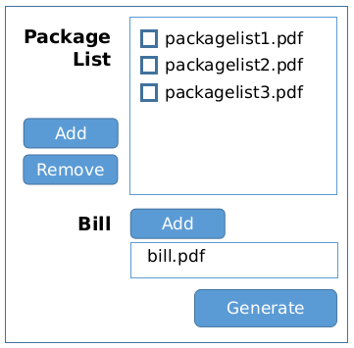
PL Info
PDF Reader
PDF Reader
PDF Reader
Correlator
EXCEL Generator
PDF Reader
Bill Info
OK
OK
BILL
OK
OK
NOK
OK
PL
XLS
PDF

